Slide 1
Introduktion til Programmering og Problemløsning (PoP)
Jon Sporring
Department of Computer Science
2022/09/02

Slide 2
F# er en lommeregner
357
864
357+864
let a = 357
let b = 864
let c = a + b
do printfn "%A" c
3 måder at køre (execute / run) programmet på:
dotnet fsi -> indtast myFirstFsharp.fsx
dotnet fsi myFirstFsharp.fsx
dotnet run myFirstFsharp.fsx

Slide 3
Nedtælling
let rec countDown n =
printfn "%A" n
match n with
0 -> ()
| _ -> countDown (n-1)
countDown 5
let countDown n =
let mutable i = n
while i >= 0 do
printfn "%A" i
i <- i - 1
countDown 5
3 måder at køre (execute / run) programmet på:
dotnet fsi -> indtast myFirstFsharp.fsx
dotnet fsi myFirstFsharp.fsx
dotnet run myFirstFsharp.fsx

Slide 4
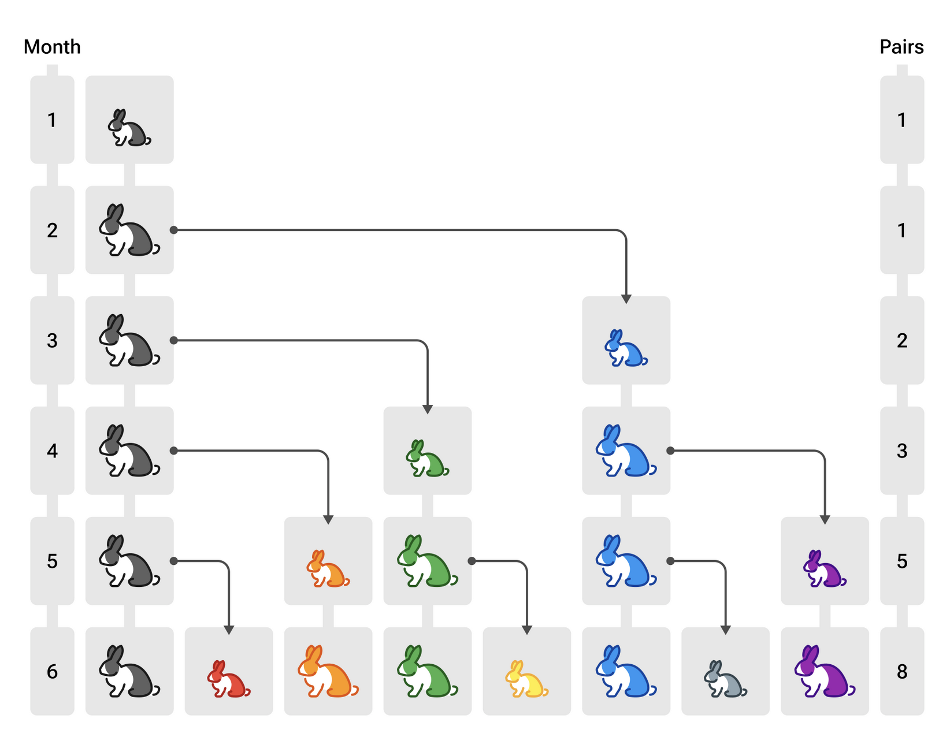
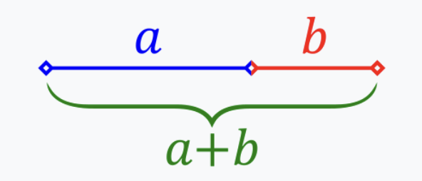
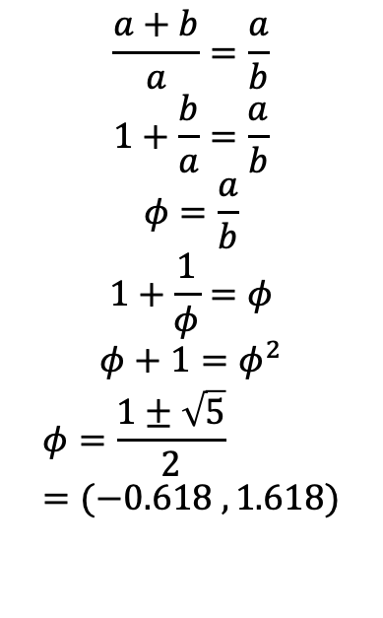
Fibonacci: 0 1 1 2 3 5 8 13 21 …
$$\frac{a+b}{a}=\frac{a}{b}$$
$$1+\frac{b}{a}=\frac{a}{b}$$
$$φ=\frac{a}{b}$$
$$1+\frac{1}{φ}=φ$$
$$φ+1=φ^{2}$$
$$φ=\frac{1±\sqrt{5}}{2}=(−0.618 , 1.618)$$
F(0) = 0
F(1) = 1
F(n) = F(n-1)+F(n-2)

Slide 5
Fibonacci: 0 1 1 2 3 5 8 13 21 …
Recursive
Imperative
% time dotnet fsi fibRecursive.fsx
fib(0) = 1
fib(1) = 1
fib(2) = 2
fib(3) = 3
fib(4) = 5
fib(5) = 8
…
fib(43) = 701408733
fib(44) = 1134903170
fib(45) = 1836311903
dotnet fsi fibRecursive.fsx 14.34s user …
let rec fib n =
match n with
0 | 1 ->
1
| _ ->
fib (n - 1) + fib (n - 2)
for i = 0 to 45 do
printfn "fib(%d) = %d" i (fib i)
let fib n =
match n with
0 | 1 ->
1
| _ ->
let mutable prevPrev = 0
let mutable prev = 1
for i = 2 to n do
let curr = prev + prevPrev
prevPrev <- prev
prev <- curr
prev
for i = 0 to 45 do
printfn "fib(%d) = %d" i (fib i)
% time dotnet fsi fibImperative.fsx
…
fib(44) = 701408733
fib(45) = 1134903170
dotnet fsi fibImperative.fsx 0.98s user …

Slide 6
Rekursion
F(0) = 0
F(1) = 1
F(n) = F(n-1)+F(n-2)
Fib(5)
= fib(4) + fib(3)
= (fib(3)+fib(2)) + (fib(2)+fib(1))
= ((fib(2)+fib(1)) + (fib(1)+fib(0)))+((fib(1)+fib(0))+1)
= (((fib(1)+fib(0))+1) + (1+0))+((1+0)+1)
= (((1+0)+1) + (1+0))+((1+0)+1)
= ((1+1) + 1)+(1+1)
= (2 + 1)+2
= 3+2
= 5

Slide 7
Rekursion
5
F(0) = 0
F(1) = 1
F(n) = F(n-1)+F(n-2)
4
3
3
2
2
1
2
1
1
0
1
0
1
0

Slide 8
Resumé
Denne video fortalte om:
F# som en lommeregner
Konstanter, typer, bindinger, betingelser, løkker, printfn
Fibonaccis talrække

